Slide 1


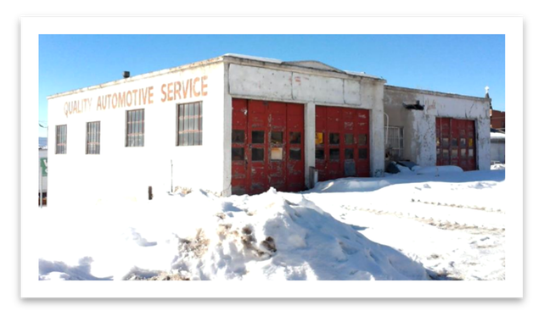
PHASE 1 ENVIRONMENTAL SITE ASSESSMENTS
BROWNFIELDS PROGRAM
How to Get a Phase 1 ESA and Why It Is Important
ALL APPROPRIATE INQUIRIES
Conducting an All Appropriate Inquiry (AAI) is considered environmental due diligence prior to acquiring a property. An AAI requires a review of previous property ownership and uses of the property. The review is a process outlined by the U.S. Environmental Protection Agency (EPA) to evaluate the environmental condition of a property and to assess potential liability for any contamination. An AAI must be conducted prior to acquiring or obtaining a property in an effort to minimize potential environmental liability as well as to maintain eligibility for State or Federal Brownfields assistance [75.10.715 MCA; CERCLA § 101(35)(A)(iii)].
Typically, a Phase 1 ESA is considered “AAI-compliant” when this report is completed by a qualified environmental professional and when it follows standards established by ASTM International (ASTM E1527-21), or the Standard Practice for Environmental Site Assessments: Phase 1 Environmental Site Assessment Process.
WHY A PHASE 1 ESA AND AAI IS IMPORTANT
The Comprehensive Environmental Response, Compensation, and Liability Act (CERCLA), also known as Federal Superfund, specifies that whenever possible, the party responsible for contamination on a property should pay for any cleanup work on a Superfund site. However, even when a previous owner caused contamination on a property, subsequent buyers, lessors, owners, and lenders can be held responsible for property cleanup. In order to promote property redevelopment, Congress amended the CERCLA law to allow for liability defenses and established standards for AAI (and Phase 1 ESAs) in 2006.
PHASE 1 ESA
When to get a Phase 1 ESA
The user of a Phase 1 ESA may be a potential purchaser of a property, a potential tenant, an owner of the property, a lender, or a property manager. A Phase 1 ESA must be conducted or updated by a prospective purchaser (or other user) within 180 days prior to a property transfer in order to obtain protections from potential environmental liabilities under CERCLA.

Slide 2
HOW TO GET AN AAI-COMPLIANT PHASE I ESA
PHASE I ESA USER RESPONSIBILITIES AND HOW TO MAINTAIN PROTECTIONS
In order to obtain liability protections offered through obtaining a Phase 1 ESA, the user has specific responsibilities to share knowledge regarding the property with the environmental professional developing the Phase 1 ESA. In order to maintain liability protections once a property has transferred, the user also must comply with “continuing obligations” during the property ownership. These obligations include complying with any land use restrictions, providing full cooperation and access to those conducting response actions on the property, and taking reasonable steps to stop or prevent continuing or future releases. To further understand specifics regarding the user’s responsibilities please refer the ASTM International (ASTM E1527-21), 40 CFR Part 312, and 42 U.S.C. 9601 et seq.
There are several ways to obtain a Phase 1 ESA for a subject property:
Hire a qualified environmental professional to conduct a Phase 1 ESA of the property.
Complete a targeted brownfields assessment (TBA). A TBA is an environmental assessment that may include a Phase 1 ESA and is funded through the Brownfields Program. Both the Montana Department of Environmental Quality (DEQ) and the EPA can provide TBAs to assist with property redevelopment. For an eligible entity, DEQ or EPA will work with an environmental professional to conduct the Phase 1 ESA on behalf of a prospective purchaser. DEQ or EPA TBA assistance is available for non-profit organizations, certified regional economic development corporations, or governmental entities (city or county). Private prospective purchasers can work with these entities to obtain a Phase 1 ESA.
Contact the DEQ or EPA Brownfields Program. For more information on how to complete and submit a TBA application, visit the following webpage(s):
View a list of Environmental Consultants in Montana
deq.mt.gov/files/Land/LUST/Documents/downloadables/
Consultlist/Environmental_Consultant_list2023.pdf
Review guidance on hiring a consultant
deq.mt.gov/files/Land/LUST/Documents/downloadables/
Consultlist/HiringAnEnvironmentalConsultant.pdf
DEQ Brownfiel﻿ds Program
deq.mt.gov/cleanupandrec/programs/brownfields
EPA Brownfields Progr﻿am
epa.gov/brownfields/r8
Note: Due to the time involved with development of an AAI-compliant Phase 1 ESA, if you have a specific property transaction or closing date, be sure to plan to initiate a Phase 1 ESA a minimum of 8 weeks prior to the closing date.
References:
42 U.S.C. 9601 et seq.
Comprehensive Environmental Response, Compensation, and Liability Act
40 CFR part 312
Standards and Practices for All Appropriate Inquiries
ASTM E1527
Standard Practice for Environmental Site Assessments; Phase 1 Environmental Site Assessment Processes
75.10.715 MCA
Liability--Reimbursement and Penalties

